Slide 1
IOT Platforms Design
Pandapotan Siagian

Slide 2
IOT Platforms Design Methodology
It includes:
Purpose & Requirements Specification
Process Specification
Domain Model Specification
Information Model Specification
Service Specification

Slide 3
IOT Platforms Design Methodology
IoT Level Specifications
Functional view Specification
Operational View Specification
Device & component Integration
Application Development

Slide 4
Functional view Specification(seventh step )
The Functional View (FV) defines the functions of the IoT systems grouped into various Functional Groups (FGs).
Each Functional Group either provides functionalities for interacting with instances of concepts defined in the Domain Model or provides information related to these concepts.

Slide 5
Functional view Specification
The Functional Groups (FG) included in a Functional View include:
Device : The device FG contains devices for monitoring and control. In the home automation example. the device FG includes a single board mini-computer, a light sensor and relay switch(actuator).
Communication : The communication FG handles the communication for the IoT system. The communication FG includes the communication protocols that form the backbone of IoT systems and enable network connectivity.
The communication FG also includes the communication APis (such as REST and WebSocket) that are used by the services and applications to exchange data over the network.

Slide 6
Functional view Specification
Services : The service FG includes various services involved in the IoT system such as services for device monitoring , device control services, data publishing services and services for device discovery.
Management : The management FG includes all functionalities that are needed to configure and manage the loT system .
Security : The security FG includes security mechanisms for the loT system such as authentication, authorization, data security, etc.
Application : The application FG includes applications that provide an interface to the users to control and monitor various aspects of the IoT system. Applications also allow users to view the system status and the processed data.

Slide 7
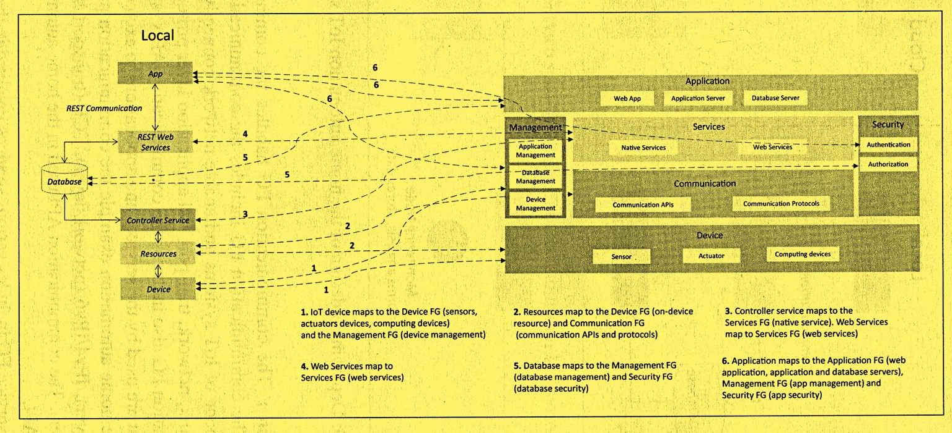
Functional view Specification

Slide 8
Operational View Specification
In this step, various options pertaining to the loT system deployment and operation are defined, such as, service hosting options, storage options, device options, application hosting options, etc.
Operational View specifications for the home automation example are as follows:
Devices: Computing device (Raspberry Pi), light dependent resistor (sensor), relay
switch (actuator).
Communication APls: REST APis
Communication Protocol s: Link Layer - 802.11, Network Layer - 1Pv4/1Pv6,
Transport TCP, Application - HTTP.

Slide 9
Operational View Specification
Operational View specifications for the home automation example are as follows:
Services:
Controller Service - Hosted on device, implemented in Python and run as a native service.
Mode service - REST-fol web service, hosted on device, implemented with Django-REST Framework.
State service - REST-ful web service, hosted on device, implemented with Django-REST Framework.
Application:
Web Application - Django Web Application, Application Server - Django App Server, Database Server - MySQL.

Slide 10
Operational View Specification
Operational View specifications for the home automation example are as follows:
Security:
Authentication: Web App, Database Authorization: Web App, Database
Management:
Application Management - Django App Management Database Management - MySQL DB Management, Device Management - Raspberry Pi device Management.

Slide 11
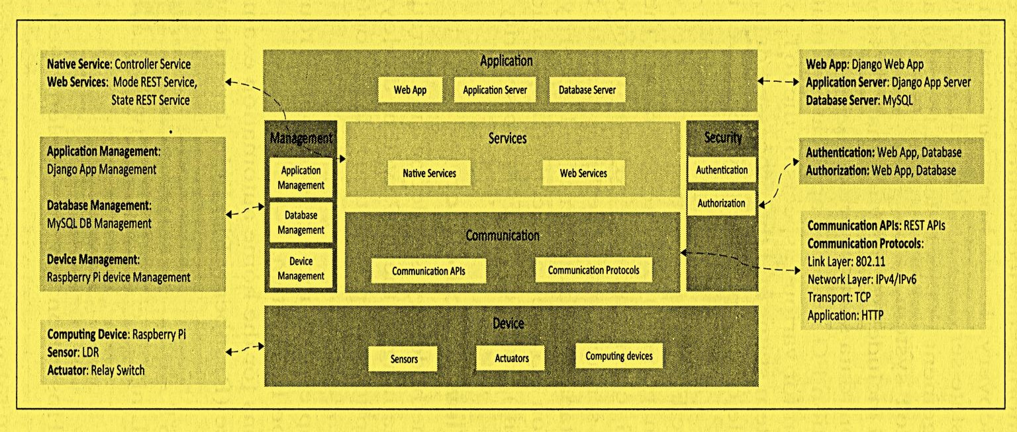
Operational View Specification

Slide 12
Thank you
51

